Slide 1












Interactive Data Visualization Project
Notes:
Hello Everyone,
my name is Maham Afzal
My team includes Tue, Mirta and Oz.

Slide 2

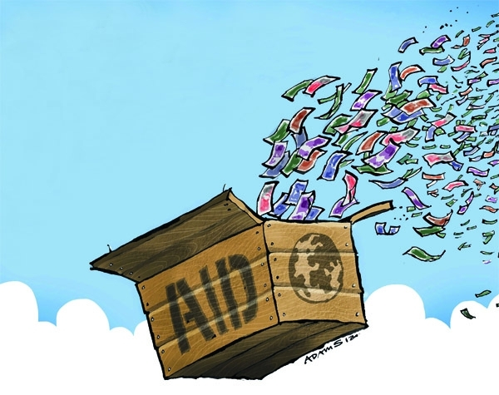

Recipients of Canadian Foreign Aid
Notes:
We decided to create a dashboard that visualizes
and provides data and analysis on Canada’s international assistance over the years, as well as the top recipients of Canadian foreign aid.
This was an interesting topic for us because our last topic we analysed the world happiness report which showed what different factors lead to a nations happiness.
this was an interesting segway because we got to include that data as well as bring in more data sets that analyzed HDI , democracy index, and foreign aid

Slide 3
Data Sources:
Human Development Index
http://hdr.undp.org/en/data
Happiness Index
http://worldhappiness.report/ed/2016/
Democracy Index
http://www.eiu.com/public/thankyou_download.aspx?activity=download&campaignid=DemocracyIndex2016
Foreign aid
https://www.international.gc.ca/department-ministere/open_data-donnees_ouvertes/dev/statistical_report_country-rapport_statistique_pays.aspx?lang=eng
Notes:
We have merged these datasets, where possible, to give a coherent time series for the reporting above.

Slide 4
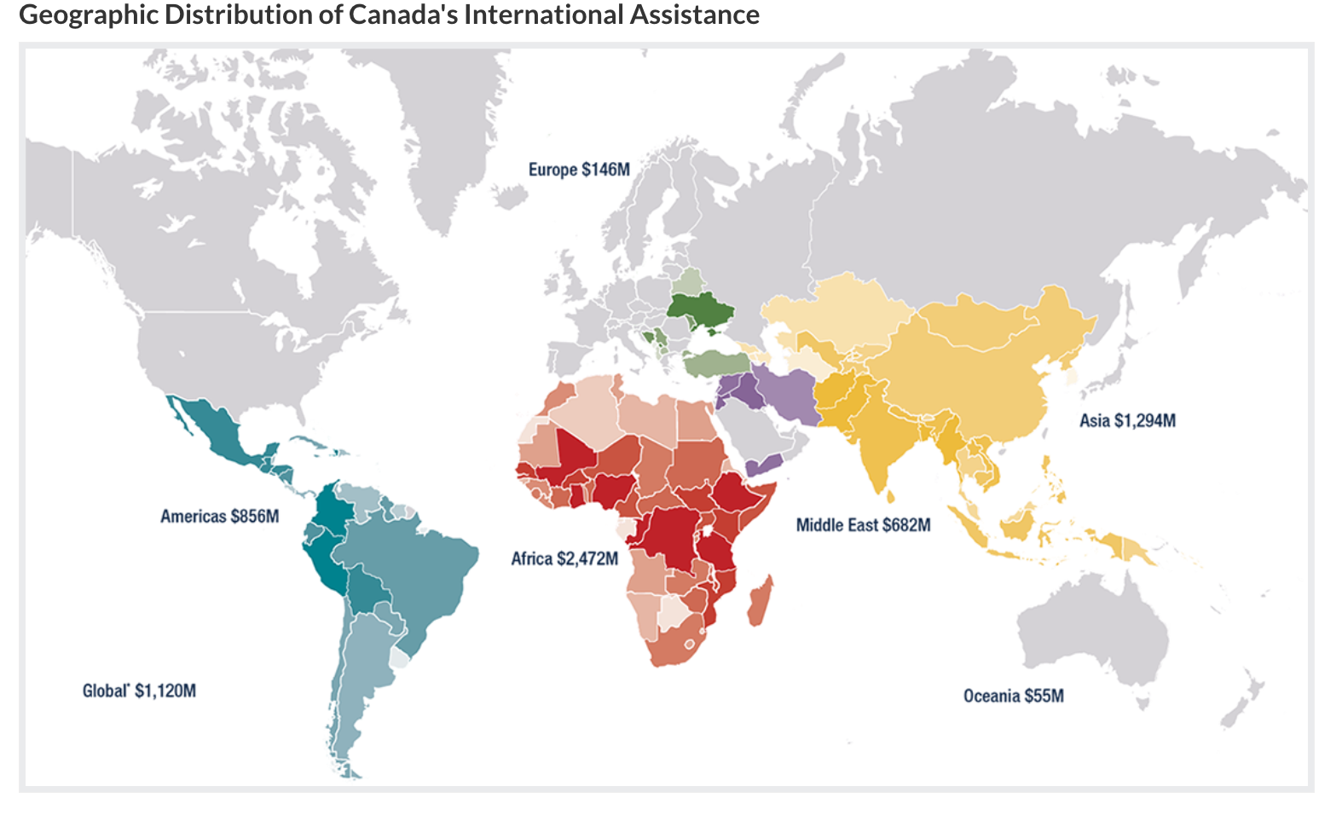
Notes:
The largest recipient in 2021 was Afghanistan (CAD$178 million), followed by Ethiopia (CAD$140 million), Lebanon (CAD$123million), South Sudan (CAD$115 million), and Mali (CAD$109 million).
African countries received the largest regional share of Canada’s international assistance at 33.3%, followed by Asia & Middle East(22.0%), the Americas (12.9%), Europe (1.9%), and Oceania (1.1%).

Slide 5
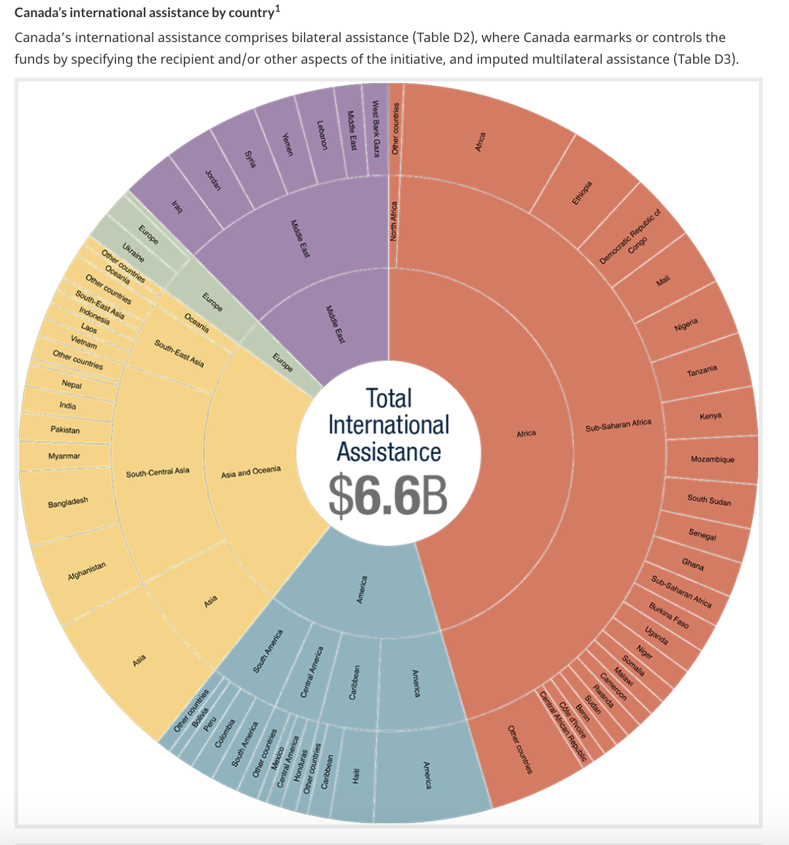
Canada’s international assistance by country:
Canada’s international assistance comprises bilateral assistance where Canada earmarks or controls the funds by specifying the recipient and/or other aspects of the initiative, and imputed multilateral assistance
Notes:
this is also an interesting visualization that shows where the total international assistance has went , as you can see , half the assistant has gone towards africa
Mirta will now go live and show our dashboard

